Slide 1
Platform Conventions
Muhammad Naqeeb

Slide 2
Outline
Introduction
Candidate for Guidelines
Human Interface Guidelines
HIG vs Material Design

Slide 3
Introduction
Platform conventions for Android and iOS refer to the design guidelines and principles that are recommended by Google and Apple respectively
Who makes the guideline?
Why we need them?

Slide 4
Candidate for Guidelines
Fluent - Windows
Material Design - Android
Human Interface Guidelines - Apple

Slide 5
Human Interface Guidelines
https://developer.apple.com/design/human-interface-guidelines/guidelines/overview/
https://developer.apple.com/design/tips/

Slide 6


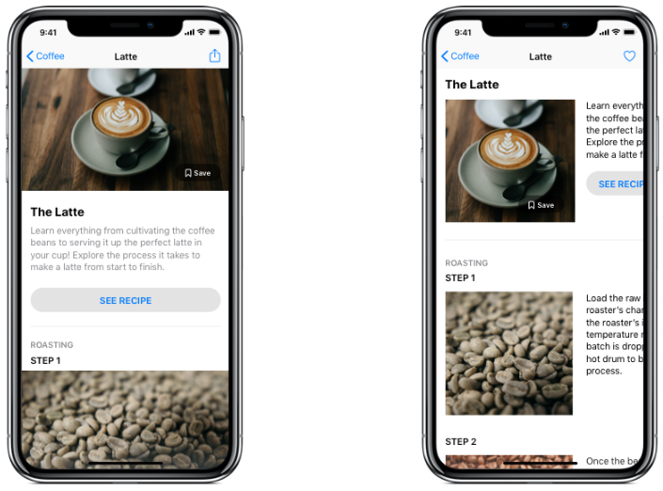
Formatting Content
Guideline
Create a layout that fits the screen of a device.
Users should see primary content without zooming or scrolling horizontally.
(a)
(b)

Slide 7
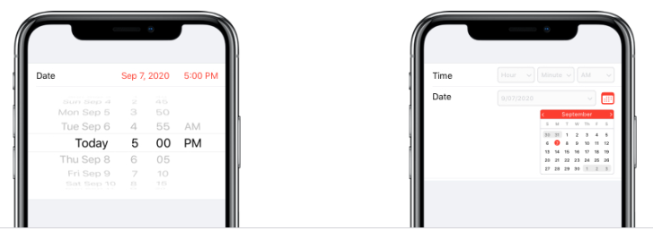
Touch Controls
Guideline
Use UI elements that are designed for touch gestures to make interaction with your app feel easy and natural.
(a)
(b)

Slide 8
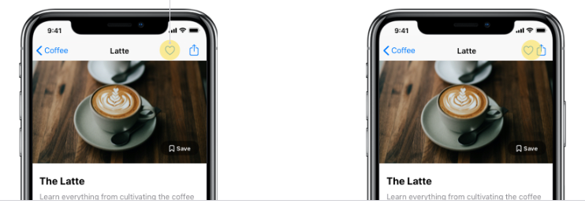
Hit Targets
Guideline
Create controls that measure at least 44 points x 44 points so they can be accurately tapped with a finger.
(a)
(b)

Slide 9
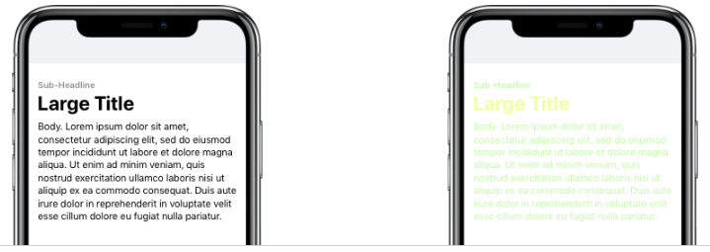
Contrast
Guideline
Make sure there is ample contrast between the font color and the background so text is legible.
(a)
(b)

Slide 10
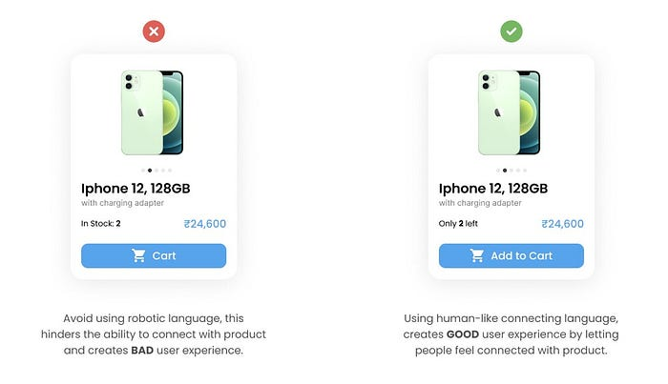
Human-like Language:
(a)
(b)

Slide 11
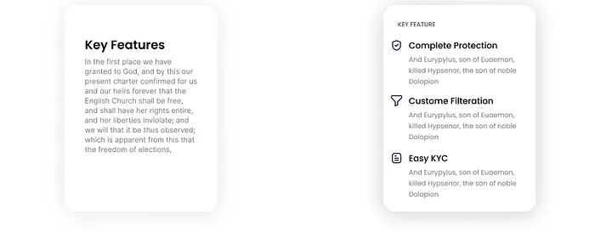
Breaking Up Content:
(a)
(b)

Slide 12
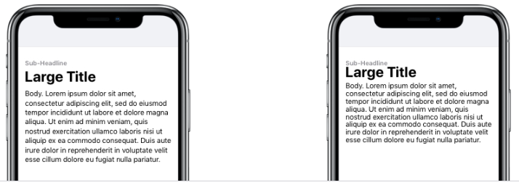
Spacing
Guideline
Don’t let text overlap. Improve legibility by increasing line height or letter spacing.
(a)
(b)

Slide 13
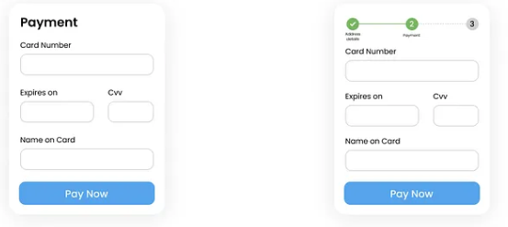
Process Bar
(a)
(b)

Slide 14
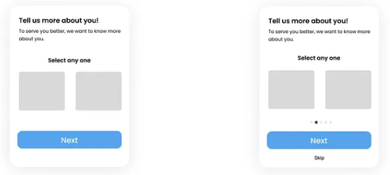
Onboarding
(a)
(b)

Slide 15
Differences

Slide 16
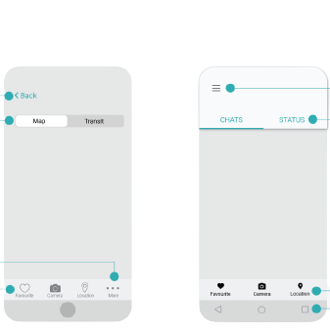
Navigation

Slide 17
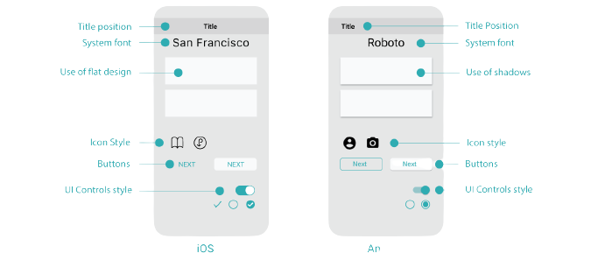
Different controls
https://github.com/muhammadnaqeeb/UI-Guidelines

Slide 18
Design is not just what it looks like and feels like. Design is how it works
“
”
- Steve Jobs
Thank you

